Slide 1

Stand out from the crowd
Connie Pontikinas
Talent Acquisition Specialist

Slide 2
Overview
Who is People’s Choice Credit Union?
The Recruitment Process - What to Expect
What Makes a Standout Candidate?
Cover Letter/Resume Tips and Tricks
Phone Interview Tips and Tricks
Cold Canvassing Tips and Tricks
Questions

Slide 3
Who is People’s Choice Credit Union?
Australia’s Second Largest Credit Union with over 360,000 members across Australia
41 Branches and 5 advice centres in South Australia, the Northern Territory, Victoria, Western Australia and the Australian Capital Territory
National Contact Centre based in Adelaide
$10 billion of funds under management and advice
Services in home loans, personal loans, financial planning and basic banking products
1,050 employees
Our members are our shareholders

Slide 4
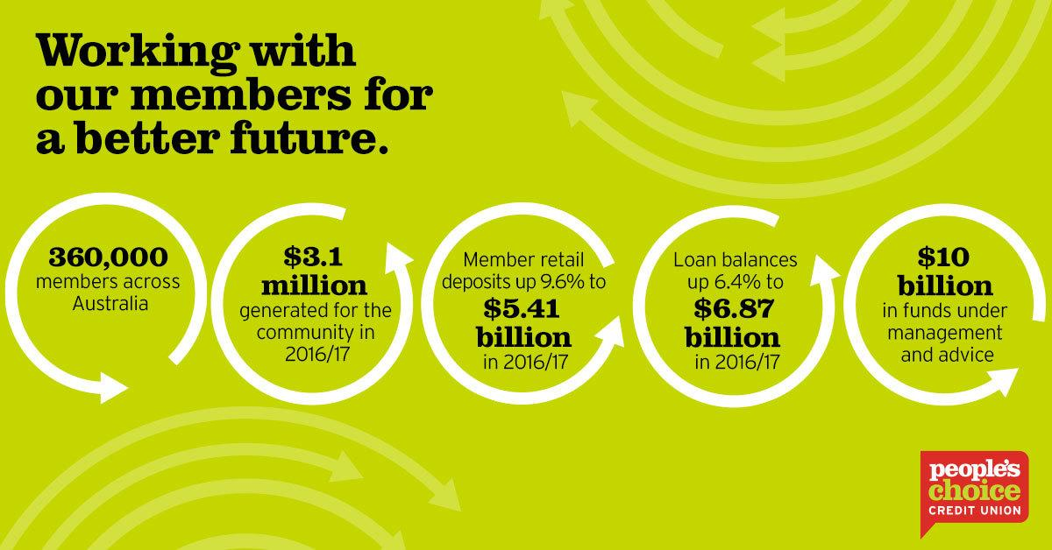



People’s Choice Credit Union

Slide 5
People’s Choice & Diversity
We are always looking at ways to diversify our workforce and have a diversity strategy in place given we are a community organisation
We offer facilities within our head office such as parent feeding rooms and reflection/prayer rooms – we are a culturally aware organisation
We consider candidates on working visa’s for employment opportunities
People’s Choice has employed candidates through Immigration SA within our National Contact Centre

Slide 6
Industry Recruitment Process
Resume screen
Phone screening shortlist
Psychometric and general reasoning assessment
Interview
Reference checks
Police check (selected organisations)
Appointment

Slide 7

What makes a standout candidate?
Strong communication skills & a positive attitude
Demonstrates drive and initiative
Shows evidence they have researched the company
Willingness to learn and evolve
Committed to a long term career
Neat business attire

Slide 8
Tips and Tricks – Cover Letter
Do:
Be concise and to the point
Keep the letter to one page
Tailor the letter to the target audience
Write with an enthusiastic tone
Use a font that is easy to read
Proof-read the letter before sending
Don’t:
Don’t repeat your resume
Don’t use a generic, impersonalised letter
Don’t include information not relevant to the job
Don’t overdo the technical jargon – translate your skills into business terms to showcase your personality

Slide 9
Tips and Tricks – Resume
Do:
Keep your resume short and uncluttered – 2 to 3 pages is best
Keep it professional
Include your contact info – this section should have your name, email address, phone number, address, LinkedIn URL if you have one
List your achievements
Use headings and sub-headings to highlight sections such as “Education, “Career History” and “Referees”
Utilise bullets and headings to keep information organised, pointed and punchy
Use keywords that match the job posting
Always check your resume for grammar and spelling – if English is not your first language, have a native speaker who also writes well review your documents
Don’t:
Try and hide gaps – be honest and confident when explaining unemployment periods – include volunteer work or education for example
List contact details that aren’t up to date
Use an unprofessional email address – i.e. ilovepuppies@hotmail.com. Think about what kind of image your email address is portraying to a prospective employer
Include information regarding marital status, date of birth, a photograph – this is not necessary and doesn’t demonstrate your skill set and experience

Slide 10
Tips and Tricks - Phone Interview
Have an active, professional voicemail
Create a checklist – review the job posting and make a list of how your qualifications match the hiring criteria – have the list available so you can glance at it during the interview
Keep your resume in clear view, so it’s at your fingertips when you need to answer questions
Do your research on the company
Have a few practical examples ready in the event you are asked any behavioural based questions that align to the job criteria
Have pen and paper handy for note-taking
Ensure you are in a quiet room free from distractions, i.e. not out and about on a busy street
If the time isn’t convenient, ask if you can call back or suggest another time

Slide 11

Cold Canvassing
Does it work?
Yes!

Slide 12
Tips and Tricks – Cold Calling
Make a list of contacts – tap into your networks or make a list of ideal companies to work for
Do your research – you’ll be able to show how much you know and prove you’re the right person for the job when calling
Write a script – it will help you to remember what to say and assist with speaking clearly
Make some practice calls – sit down with a friend or family member
Work out when to call – there are good and bad times during the day to call – avoid the start or end of a working day or during lunch
Schedule a time to have a chat – gauge the temperature and if it’s the right time
Get your gear together – paper and pen to take notes, a copy of your resume and your script

Slide 13
Tips and Tricks – Cold Calling
Dress to impress – dressing as though your going to work or an interview will put you in a more professional frame of mind when making calls
Stay focused – find somewhere quiet to call, away from interruptions or distractions
Be polite and smile – smiling will project a positive image and will change the tone of your voice
Take notes – keep track of who you’ve called and the outcome of your conversation
Review the call and confirm next steps – i.e. submit your resume, connect via LinkedIn etc
Be persistent – if you haven’t heard back within a week or two, don’t be afraid to call back
Don’t get discouraged – not every call will end in a good result, but don’t be shy to ask for advice about someone else who may be able to help or another business you could contact about finding work – keep calling until something works out

Slide 14

Questions?

