Slide 1
An Overview of the Labour Market
28 August 2018, Spotlight Seminar – Localising your skills and experience
Michael McKay
Principal Economic Analyst,
Department for Industry and Skills
Notes:
Skilled migrants are part of the solution to the economic growth challenge facing South Australia.
South Australia has typically recorded subdued economic growth and one of the key constraints on our growth has been our demographics – namely, our subdued population growth rate and an ageing population.
So skilled migration will be hugely important for us going forward to support population growth, and to provide the skills required as older workers retire and the State’s industry structure changes towards an increased focus on high value-add goods production and knowledge-intensive services – including services requiring a high level of expertise and education.

Slide 2
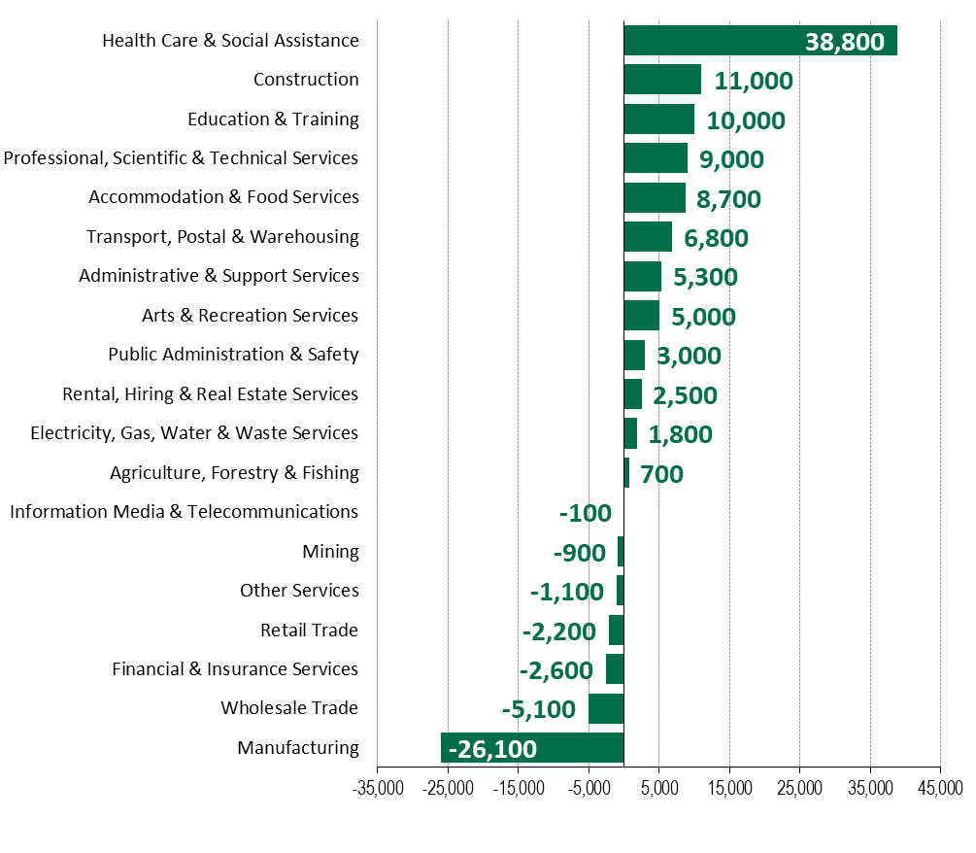
South Australia – an economy in transition
Notes:
South Australia is an economy in transition moving away from labour intensive manufacturing and towards other indusytries.
The ageing of the population is contributing to jobs growth in the health care and social assistance industry (including hospitals, GP services, aged care etc) with this industry now being the largest employing local industry and the most significant contributor to growth in the demand for workers.
With the continued advancement and development of our economy, there has been employment growth for professional, scientific and technical services (like legal and accounting services, engineering, advertising, computer system design etc) – high value-add knowledge-intensive services – services that require a high level of expertise and education.
With the continued advancement and development of our economy, there has been an increased demand for education and training as people need to participate in this sector in order to acquire the skills required to work in this new economy. Also, as South Australia continues to attract more international students, this also supports jobs growth in the education and training industry, as well as other supporting industries.
The construction industry has been the second strongest contributor to employment growth as investment continues to support the housing, engineering, and commercial construction needs of a growing and changing population and business community, as well as government investment supporting the growth and development of the State’s economy.
Government initiatives like the National Disability Insurance Scheme will create jobs related to assisting people with a disability in their daily living. Jobs include a variety of allied health professionals, personal care workers and so on, but also includes supporting roles in areas like office work. Defence projects in the coming years will create work for a variety of managers, engineers, clerical and administrative workers, technicians and trades workers, machine operators and drivers, and labourers.
The size of the South Australia’s manufacturing workforce has been impacted by various factors such as the previously high Australian dollar, foreign competition from low cost producers, and manufacturers moving to less labour-intensive production methods.

Slide 3
Major Projects
Gas, renewable and battery storage projects
$650 million Aurora Solar Energy Project (job ads at https://www.solarreserve.com/en/about/careers)
$1.5 billion Ceres wind farm on the Yorke Peninsula (register interest in future employment opportunities at http://www.theceresproject.com.au/register_here)
Engineering projects underway
$916 million Carrapateena copper-gold project (https://career10.successfactors.com/career?company=ozmineralsP)
$896 million South Road Upgrade (http://www.t2talliance.com.au/our-commitment/employment/)
$885 million Northern Connector (www.northhub.sa.gov.au)
Notes:
There are a number of major projects underway or in the pipeline in South Australia.
I have provided some links for some of the major projects in South Australia.
Usually the relevant website will provide information on the related job opportunities or at least provide you with the opportunity to register your interest in any upcoming jobs.
Northhub also provides an opportunity to register your interest in job opportunities for the Gawler Rail Electrification Project and the Osborne Naval Shipbuilding Precinct.

Slide 4
Major Projects
Engineering projects in the pipeline
$4.5 billion Central Eyre iron ore project (register interest at http://ironroadlimited.com.au/about-us/employment)
$3.2 billion Arckaringa project
$2.8 billion Olympic Dam brownfield expansion (https://www.bhp.com/our-approach/work-with-us)
Commercial projects underway
$610 million redevelopment of Adelaide Festival Plaza
$330 million expansion of Adelaide Casino

Slide 5
Major Projects
Commercial projects in the pipeline
$528 million new Women’s and Children’s Hospital
$400 million Central Market Arcade redevelopment (https://www.cityofadelaide.com.au/your-community/programs-projects/placemaking/market-district/arcade-redevelopment/contact-us)
Infrastructure Projects
https://www.infrastructure.sa.gov.au/infrastructure_projects
Major Developments
https://www.saplanningportal.sa.gov.au/current_planning_system/development_assessment/development_activity_maps#major

Slide 6
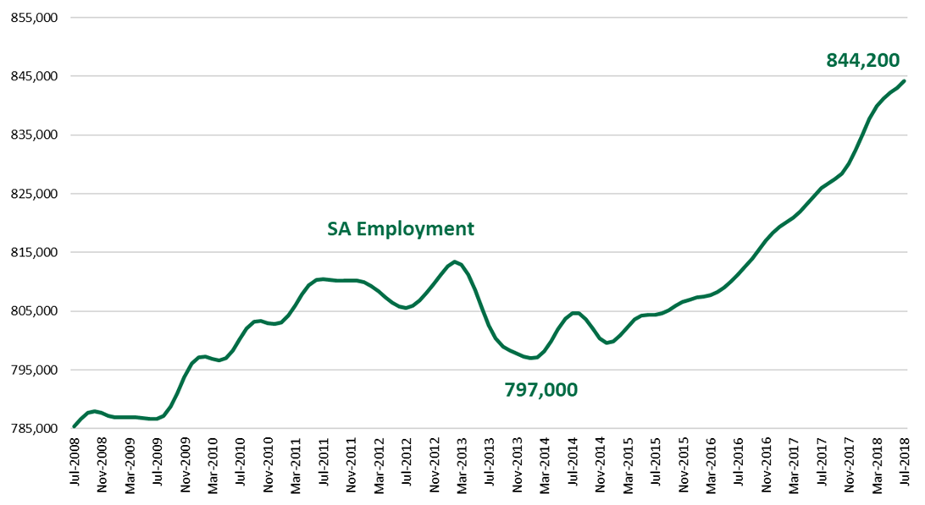
Increasing employment is good for job seekers
Notes:
The jobs market has been looking stronger in recent years with employment increasing. That’s good for job seekers because this is reflecting an increasing demand for workers.

Slide 7
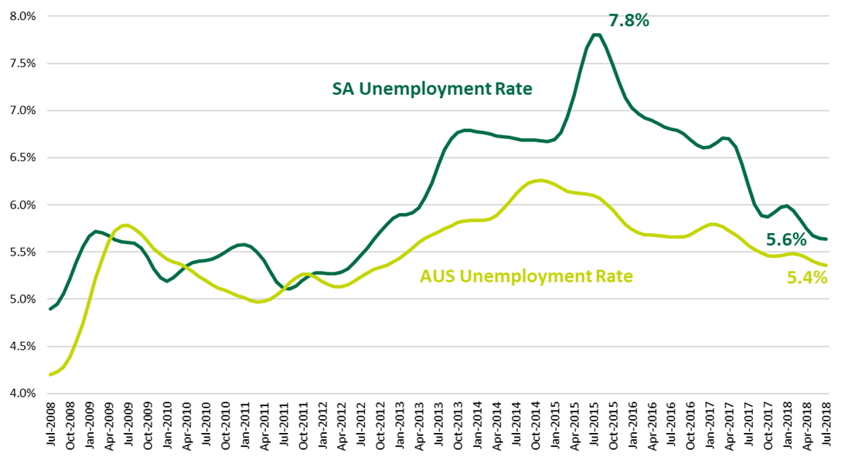
Lower unemployment rate is good for job seekers
Notes:
As unemployed people have been gaining employment in recent years, the State’s unemployment rate has declined and is now quite low. This is good for job seekers because it means that there are fewer unemployed people to compete with for those new employment opportunities.

Slide 8
Highest number of vacancies
Professionals (26% of vacancies)
registered nurses (240)
software and applications programmers (200)
accountants (160)
human resource professionals (120)
civil engineering professionals (90)
ICT business and systems analysts (90)
welfare, recreation and community arts workers (70)
generalist medical practitioners (60)
advertising and marketing professionals (60)
Notes:
1 in 4 vacancies are for professional jobs like registered nurses, programmers, accountants, and human resource professionals.

Slide 9
Highest number of vacancies
Professionals (cont.)
industrial, mechanical and production engineers (50)
training and development professionals (30)
social workers (30)
management and organisation analysts (30)
electrical engineers (20)
ICT support and test engineers (20)
computer network professionals (20)
telecommunications engineering professionals (<10)

Slide 10
Highest number of vacancies
Technicians and Trades Workers (16% of vacancies)
motor mechanics (170)
electricians (120)
metal fitters and machinists (110)
chefs (100)
structural steel and welding trades workers (90)
architectural, building and surveying technicians (80)
ICT support technicians (50)
cooks (50)
Notes:
16% of vacancies were for technicians and trades workers like motor mechanics, electricians, and metal fitters and machinists.

Slide 11
Highest number of vacancies
Clerical and Administrative Workers (16% of vacancies)
general clerks (400)
receptionists (120)
accounting clerks (80)
call or contact centre workers (80)
contract, program and project administrators (80)
purchasing and supply logistics clerks (60)
office managers (50)
credit and loans officers (40)
payroll clerks (40)
Notes:
16% of vacancies are for clerical and admin jobs with a high number of vacancies being recorded for general clerks (that perform a range of clerical and admin tasks like routine reports, and recording and filing information.

Slide 12
Highest number of vacancies
Clerical and Administrative Workers (cont.)
bank workers (30)

Slide 13
Highest number of vacancies
Managers (11% of vacancies)
advertising and sales managers (180)
construction managers (150)
retail managers (110)
policy and planning managers (50)
production managers (40)
other hospitality, retail and service managers (30)
other specialist managers (30)
general managers (30)
finance managers (30)
Notes:
1 in 10 vacancies are for managers with vacancies in advertising and sales, construction and retail.
Other specialist managers include quality assurance managers.

Slide 14
Highest number of vacancies
Managers (cont.)
corporate services managers (30)
engineering managers (10)
supply and distribution managers (10)

Slide 15
Highest number of vacancies
Labourers (9% of vacancies)
other miscellaneous labourers (230)
commercial cleaners (60)
building and plumbing labourers (40)
kitchenhands (30)
Notes:
1 in 10 vacancies are for labourers. A number of vacancies for other miscellaneous labourers, which could include categories like electronic or telecommunications trades assistants, mechanic’s assistant, bicycle mechanics, trolley collectors etc.

Slide 16
Highest number of vacancies
Sales Workers (8% of vacancies)
sales assistants (320)
sales reps (100)
real estate sales agents (50)
motor vehicle and vehicle parts salespersons (30)
Notes:
A significant number of vacancies in sales assistants with staff turnover no doubt playing a role here. Sales reps is also a contributor.
In South Australia, the main contributor to job openings for new entrants is the need to replace leaving workers (as opposed to employment growth).

Slide 17
Highest number of vacancies
Community and Personal Service Workers (8% of vacancies)
aged and disabled carers (130)
waiters (60)
child carers (40)
bar attendants and baristas (40)
dental assistants (40)
welfare support workers (40)
education aides (30)
Notes:
The highest number of vacancies for Community and Personal Service Workers is for aged and disabled carers with the ageing of the population driving demand for these workers.

Slide 18
Highest number of vacancies
Machine Operators and Drivers (7% of vacancies)
truck drivers (140)
storepersons (80)
earthmoving plant operators (60)
forklift drivers (60)
Notes:
The highest number of vacancies for Machine Operators and Drivers is for truck drivers.

Slide 19
Websites
Check out our website
www.skills.sa.gov.au
select careers & jobs
Choosing your career
Growth industries
Labour market information

Slide 20
Websites
Keep an eye on job advertisements
www.seek.com.au
www.linkedin.com
https://iworkfor.sa.gov.au/
Keep an eye on general trends in job advertisements
http://lmip.gov.au/LMIP/VacancyReport

Slide 21
Websites
Keep an eye on general trends in employment growth
www.abs.gov.au
Select Statistics, Catalogue Number, 6. Labour Statistics and Prices, 62. Labour Force,
Cat. No. 6202.0 – table 7
Cat. No. 6291.0.55.003 – moving annual average data – table 5 for industry data and datacube EQ08 for occupation data

Slide 22
Websites
What do the occupation and industry titles mean?
Occupations
http://www.abs.gov.au/AUSSTATS/abs@.nsf/DetailsPage/1220.0First%20Edition,%20Revision%201?OpenDocument
Industries
http://www.abs.gov.au/AUSSTATS/abs@.nsf/DetailsPage/1292.02006%20(Revision%202.0)?OpenDocument

